Slide 1



Testing
repo: https://github.com/shalenyj/testing-vue-app
Ap lication
Notes:
Github repo: https://github.com/shalenyj/testing-vue-app

Slide 2



+
=
Notes:
Vue test-utils: https://github.com/vuejs/vue-test-utils Jest: https://jestjs.io/

Slide 3

Snapshot
Notes:
Jest tutorial: https://jestjs.io/docs/snapshot-testing

Slide 4
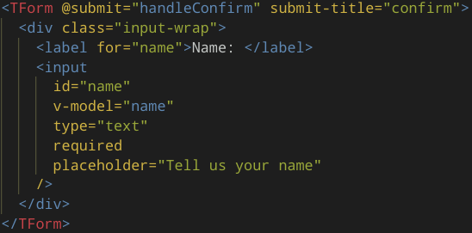
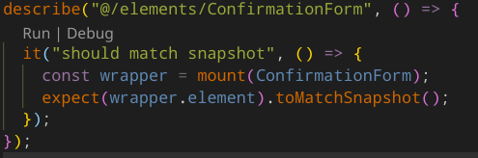
Component
Snapshot Test

Slide 5
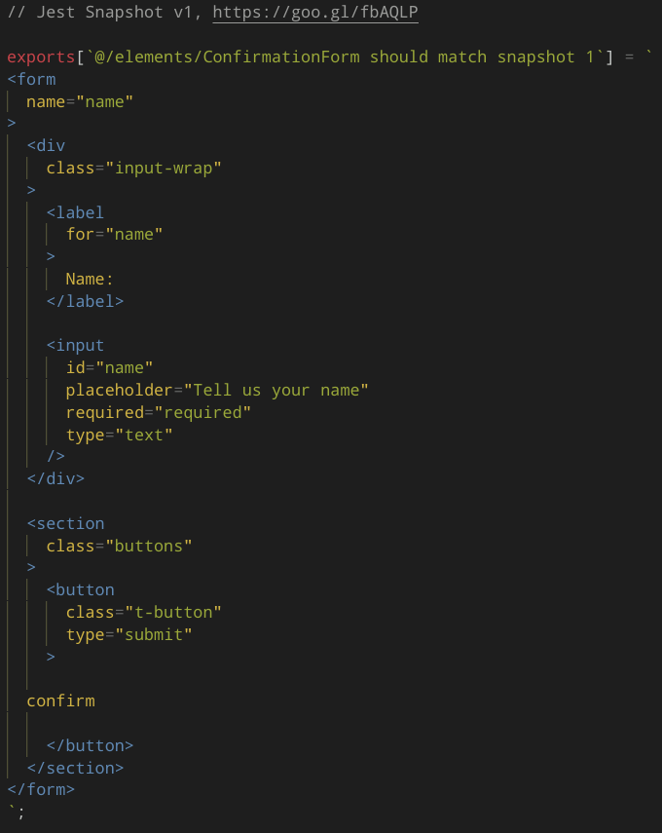

Snapshot File

Slide 6
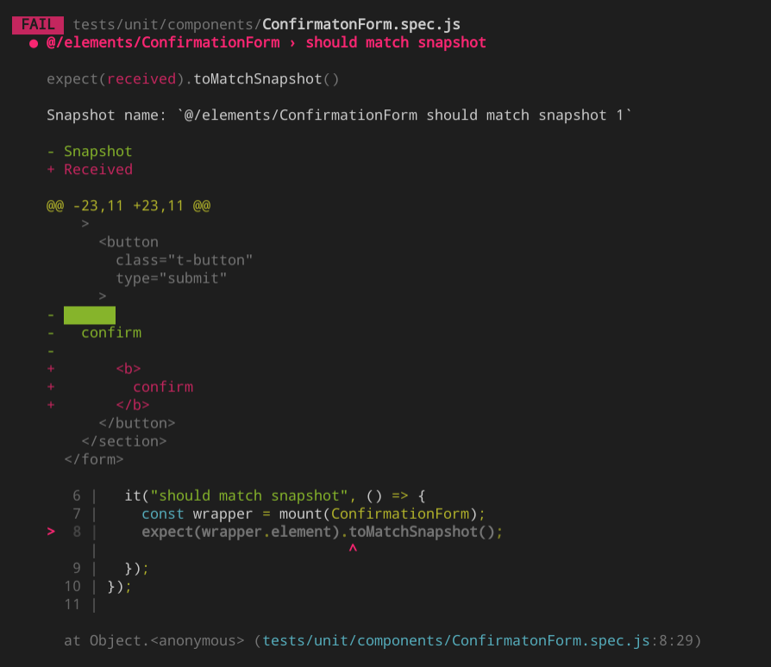
Test Failure

Slide 7
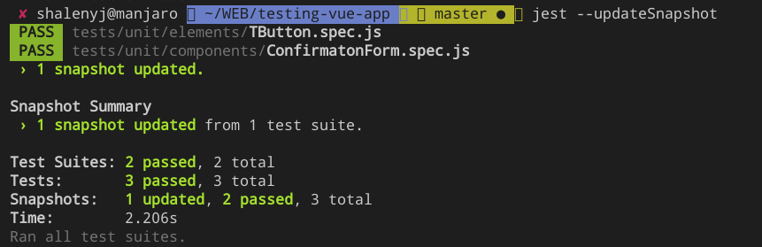
Update Snapshot after EXPECTED UI changes

Slide 8
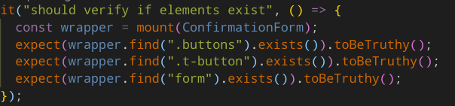

Unit test
Snapshot Test

Slide 9

Unit

Slide 10
How?
Why?
When?
Test your code, not code of packages, libraries, frameworks
Every test should be encapsulated
Dependencies and interactions to the outside world are stubbed or mocked.
You can test each “brick” separately
Allows Test Driven Development
Improve understanding of code
May be used instead of docs
Any Javascript function
Business logic

Slide 11

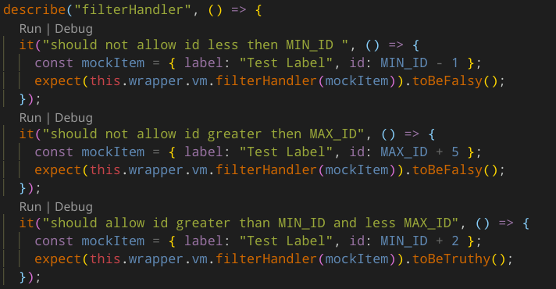
Vue method
Unit test

Slide 12

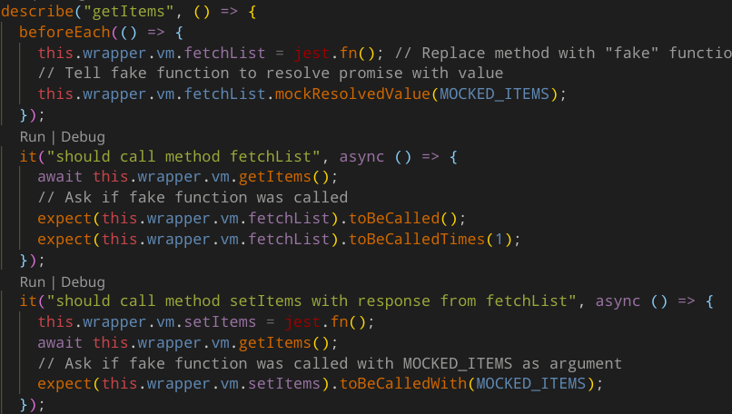
Vue method
Unit test

Slide 13
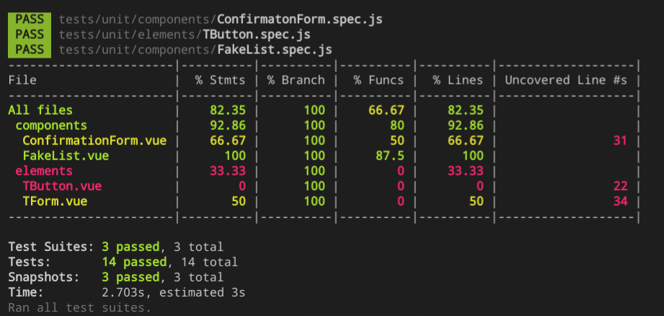
Code Coverage

Slide 14
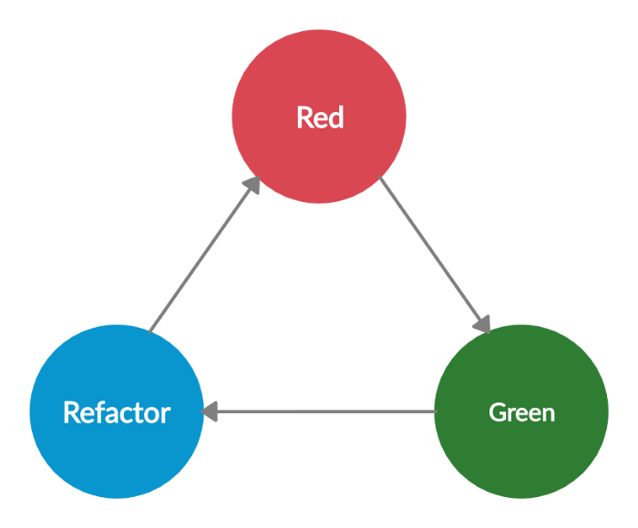
Test Driven Development (TDD)

Slide 15

Component
Integration

Slide 16

E2E

Slide 17
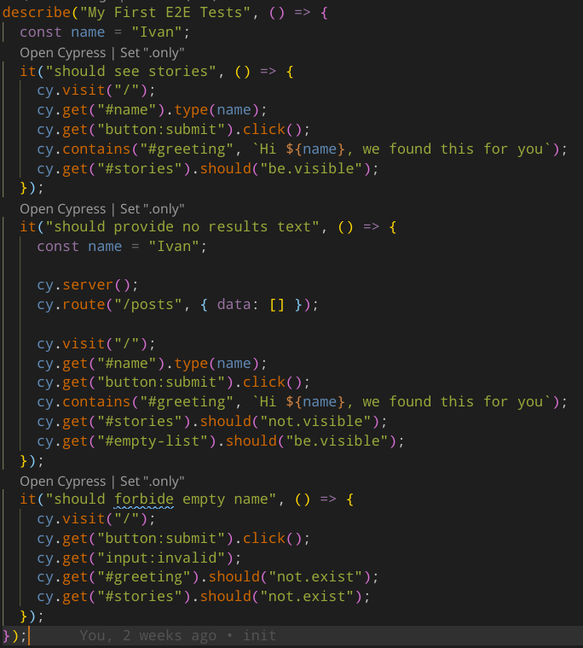
First E2E Test

Slide 18
When?
Why?
Cons
Important user scenarios
Scenarios with tons of variants
Huge reduce load on QA team
More complex than unit-tests
Takes time to maintain
Require some CI/CD
Sensitive to UX/UI changes

Slide 19

Beyond
Notes:
Web Securiry - https://owasp.org/
SonarQube tool for catching vulnerabilities https://www.sonarqube.org/
Eslintt plugin for browser-compatibility https://www.npmjs.com/package/eslint-plugin-compat

